Slide 1

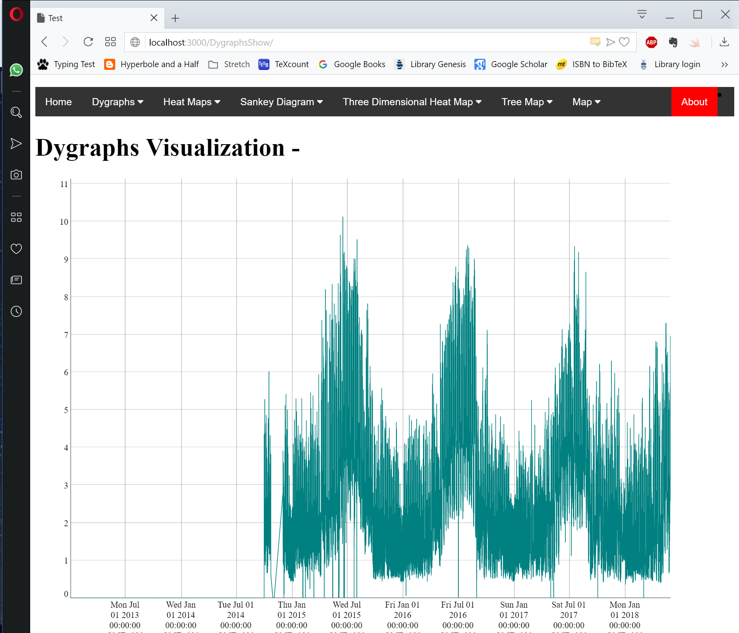


Template files
(Eg. index.html and dygraphs.css)
Layout
Jinja2
HTML Page
Data
Werkzeug
(Web Server Gateway Interface)
Flask
Data
Input
Python
Python files
(Eg. App.py)
Python Requests
Returned Data
OpenTSDB
Query

